Slide 1
Ravendb – VOROn
Michael Yarichuk
Hibernating rhinos
michael.yarichuk@hibernatingrhinos.com

Slide 2
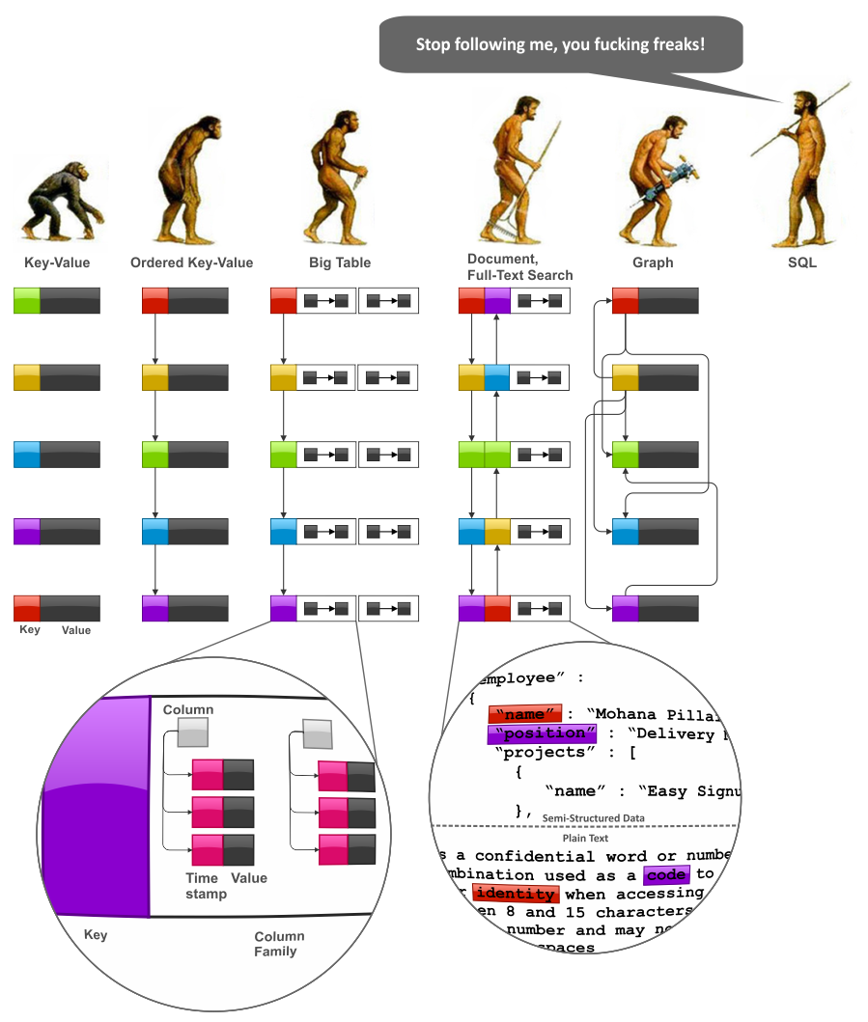
Darwin Theory at work
Ordered Key-Value store is relatively primitive
Simple and fast
http://highlyscalable.wordpress.com/2012/03/01/nosql-data-modeling-techniques/

Slide 3
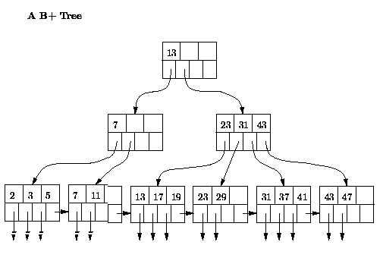
B+ TreE
http://infolab.stanford.edu/~ullman/dbsi/win98/hw2.html

Slide 4
Voron
ACID guaranteed
Snapshot Isolation
Key-value store
Data in B+ trees
Supports sub-trees
Write-ahead log
Append-only journalling
Notes:
Scratch journal,
Append-only journal for crash recovery, log shipping

